Slide 1
Relocation Recommendation in Singapore

Slide 2
Business problem
This project will be useful for agencies and their customers or also direct individuals who are in search of a right accommodation for themselves.
In the project, the city of Singapore is considered which is undoubtedly the most attracted for people across the world.
Singapore is segmented into different neighborhoods using the geographical coordinates of different buildings and the geographical coordinates of top 100 venues around a particular building.
Finally, the neighborhoods are grouped into clusters.

Slide 3
Data
The main datasets used are ‘Singapore_geo.csv’ and ‘sg_random_samles_clean’ which provide information about all the postal codes.
The latitude, longitude, postcode and building are extracted from the datasets.
The dataset is cleaned by removing all the null values.
Further, Foursquare API is used to extend the dataset and select random buildings for analysis.

Slide 4
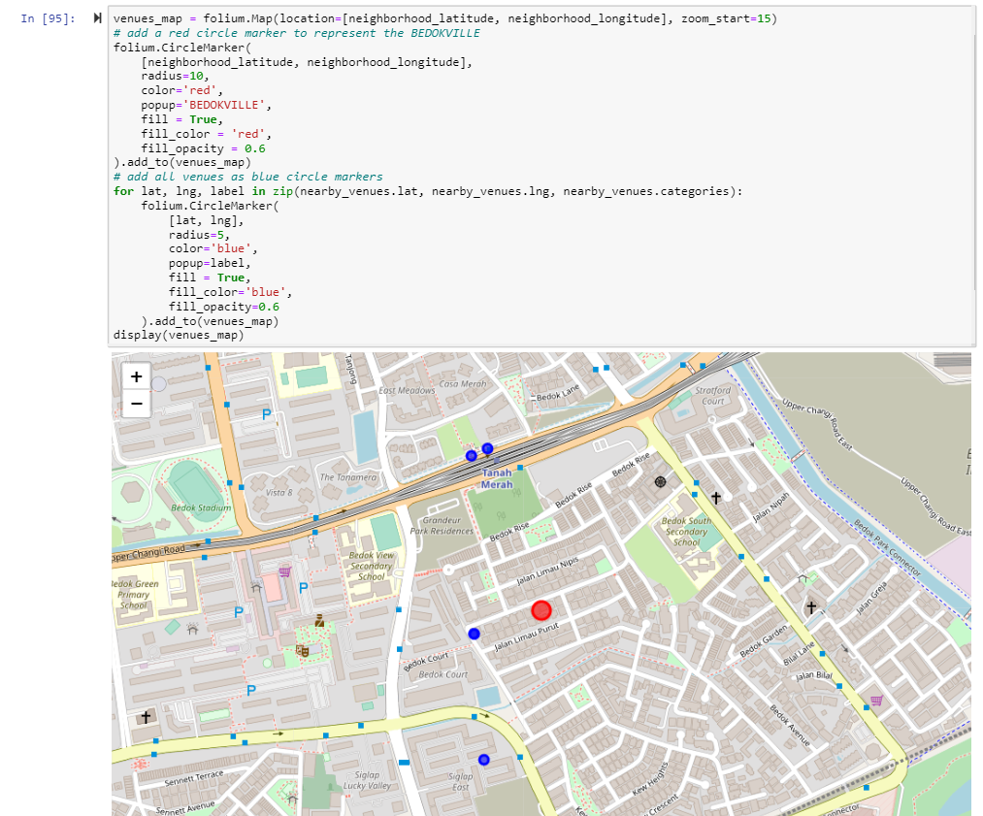
Output screens

Slide 5
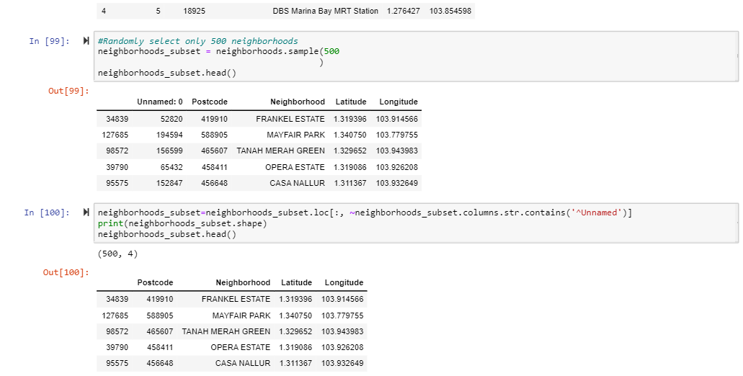

Slide 6
